Slide 1
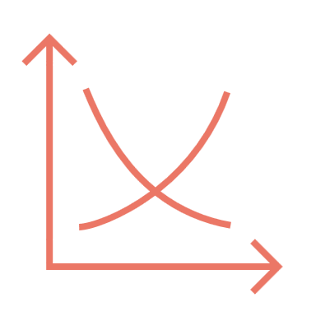




Iron Ore Price vs. Perth Housing Market
Khansa
2008-2021
Khansa Rubab Malik
Johan Snyman
Joseph Koroma
Group_3_Project 1_EDA

Slide 2

Khansa
Is there a correlation between the iron ore price cycle and Perth’s residential property prices?
How do the iron price rise and fall impact the Perth residential property price weighted average index?
How does the quarterly price vary over the research time period?
How does the relation ship between iron ore price rise and fall affect the future of the Perth property market
Which questions do we want to answer?

Slide 3
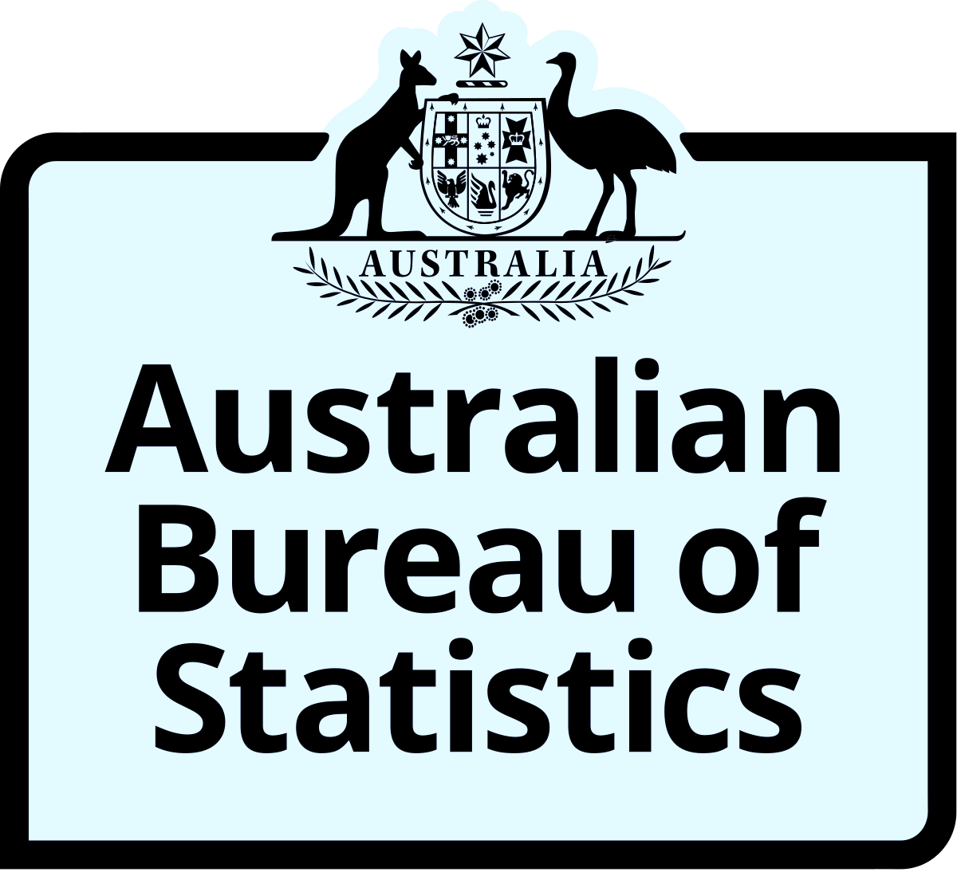




Khansa
Data sources and information
https://explore.data.abs.gov.au/vis?tm=perth%20house%20prices&pg=0&df[ds]=ECONOMY_TOPICS&df[id]=RPPI&df[ag]=ABS&df[vs]=1.0.0&pd=2008-Q1%2C2021-Q1&dq=2%2B1%2B3.1%2B2%2B3..Q&ly[cl]=REGION&ly[rw]=TIME_PERIOD&ly[rs]=MEASURE&fc=Measure&vw=tb
url1 = "https://api.data.abs.gov.au/data/ABS,RPPI,1.0.0/1.2.5GPER+100.Q?startPeriod=2018-Q4&endPeriod=2021-Q4&dimensionAtObservation=AllDimensions&format=jsondata"
https://www.rba.gov.au/statistics/tables/xls/g01hist.xls
https://www.worldbank.org/en/research/commodity-markets
https://www.kaggle.com/datasets/syuzai/perth-house-prices
https://www.aussie.com.au/content/dam/aussie/documents/home-loans/aussie_25_years_report.pdf
https://www.omi.wa.gov.au/docs/librariesprovider2/archive/economic-and-social-contribution-of-migrants-to-western-australia.pdf?sfvrsn=995124a0_2
https://www.therealestateconversation.com.au/news/2022/08/29/corelogic-property-pulse-spring-special-the-long-game-30-years-housing-values

Slide 4
Khansa
Data exploration & clean up process
Create a single point of view to tell the story through the data analysis
Load and Read house Data File
Reduce and rename to Required columns (By deleting duplicate
Verify counts, check unique values and create PERTH specific DF
Load, Clean and Merge Iron data with housing data
Design and Print Graphs to explore relationship
BONUS!!!!
Develop and deploy an API to collect the housing data

Slide 5
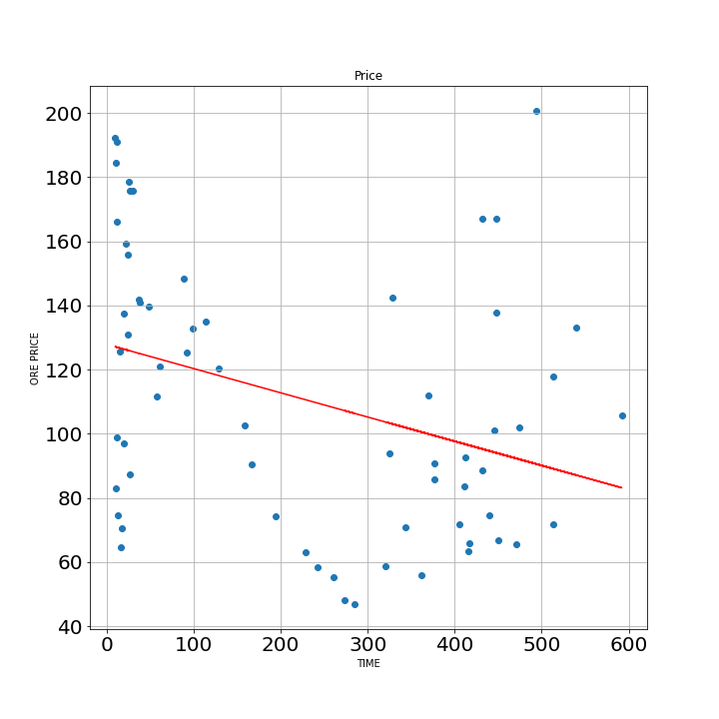
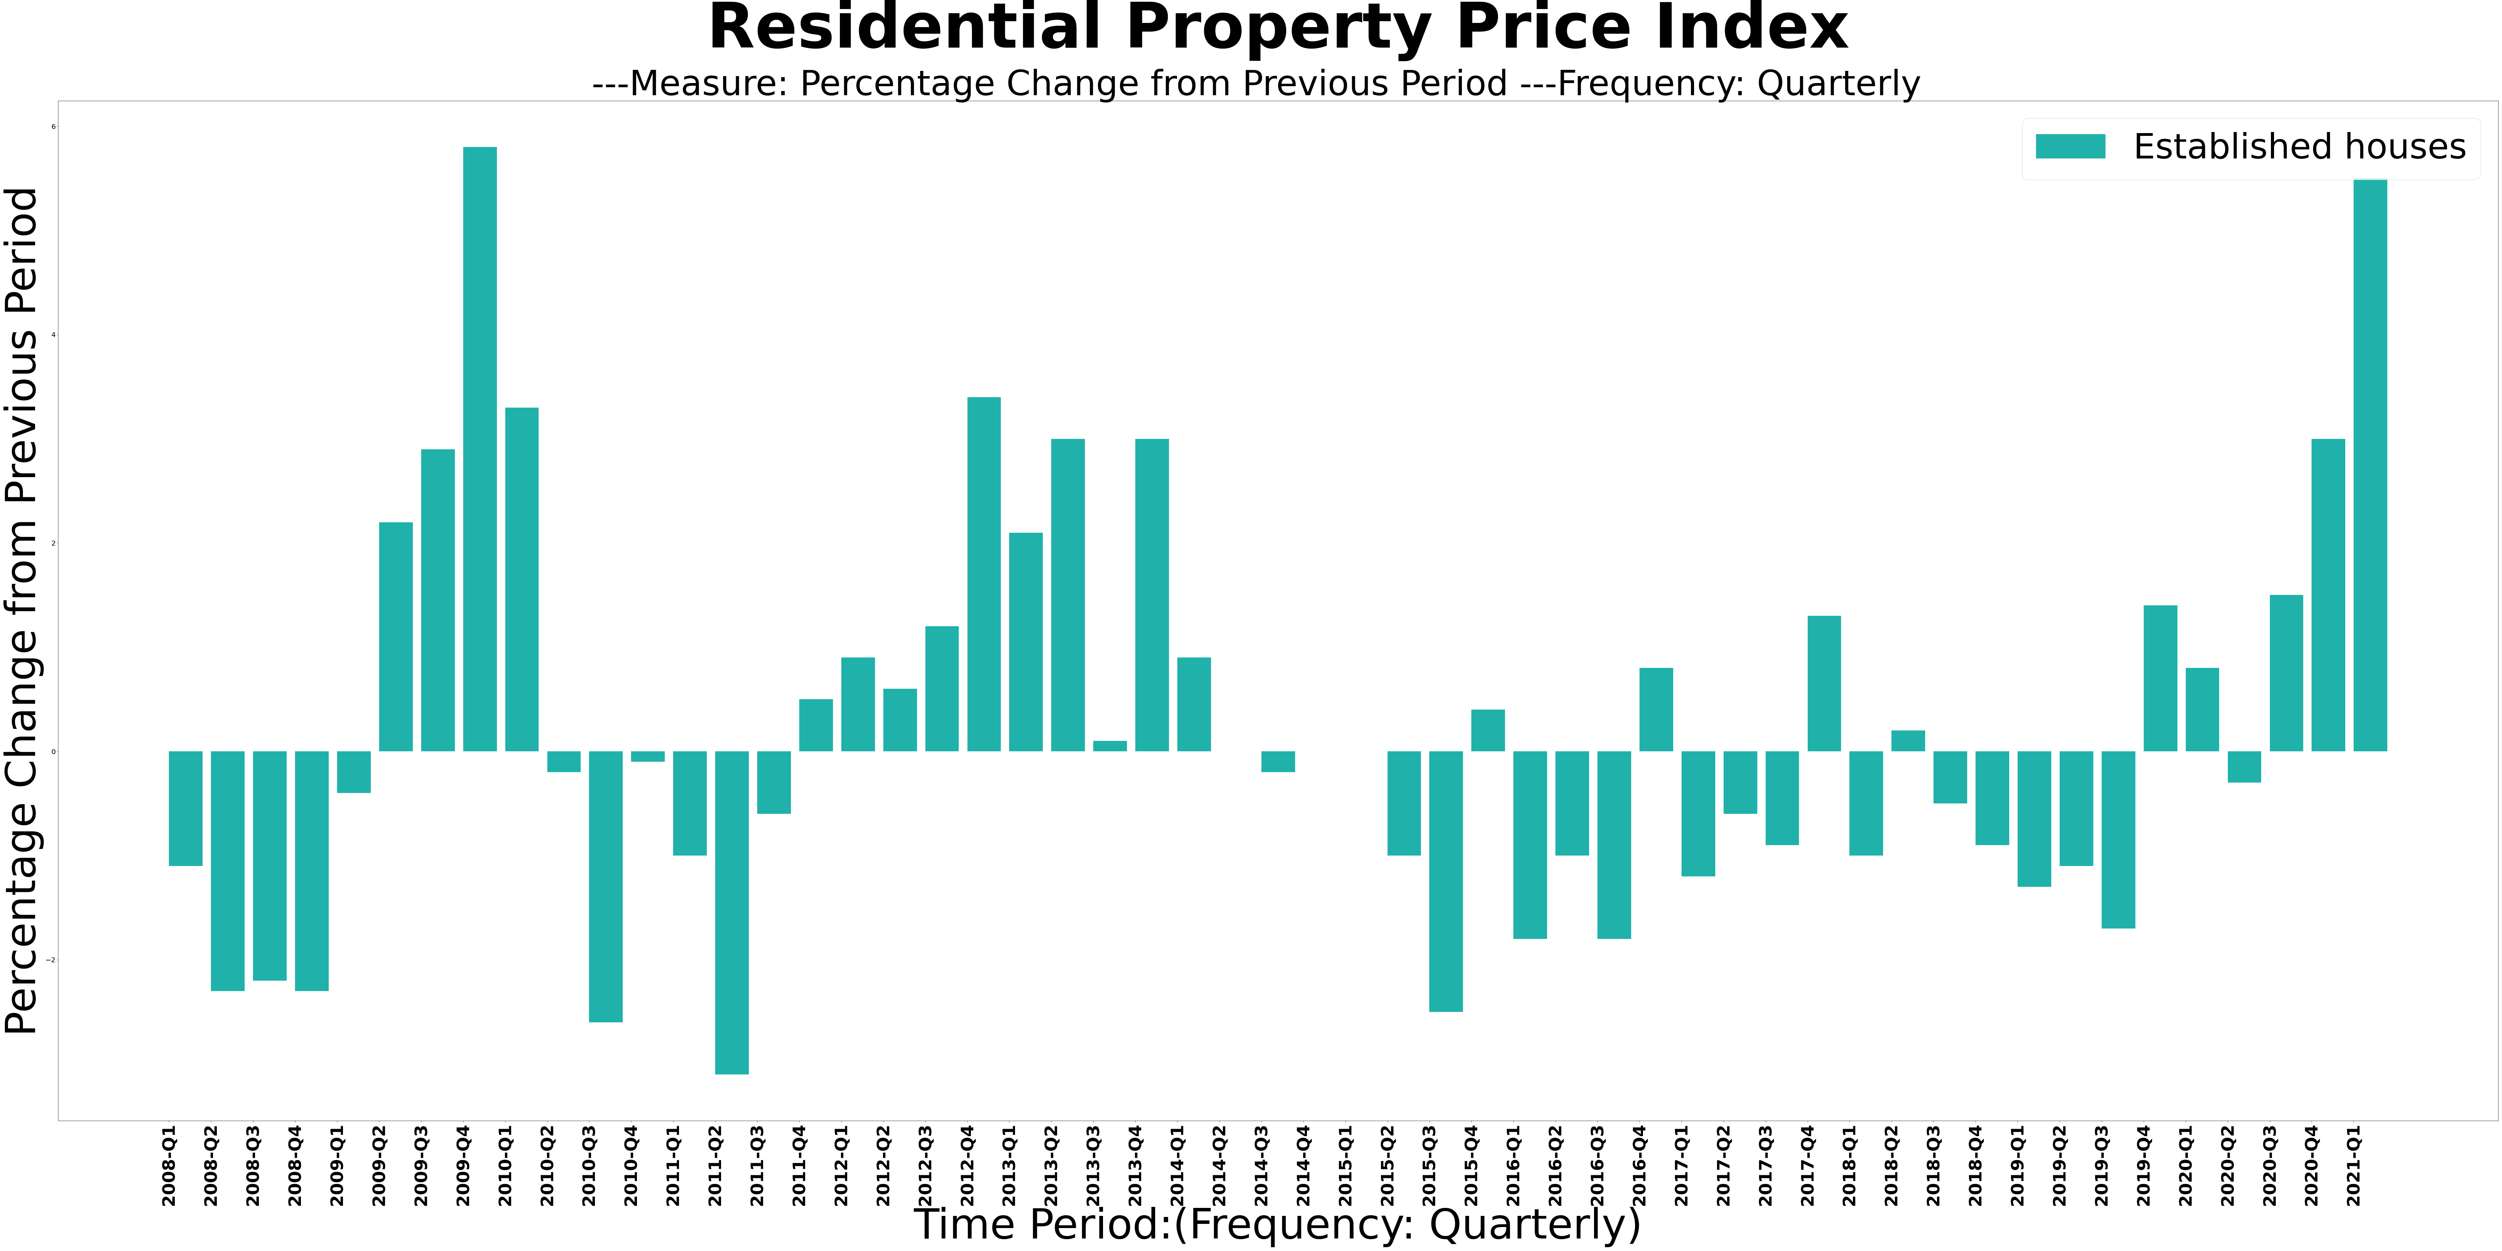
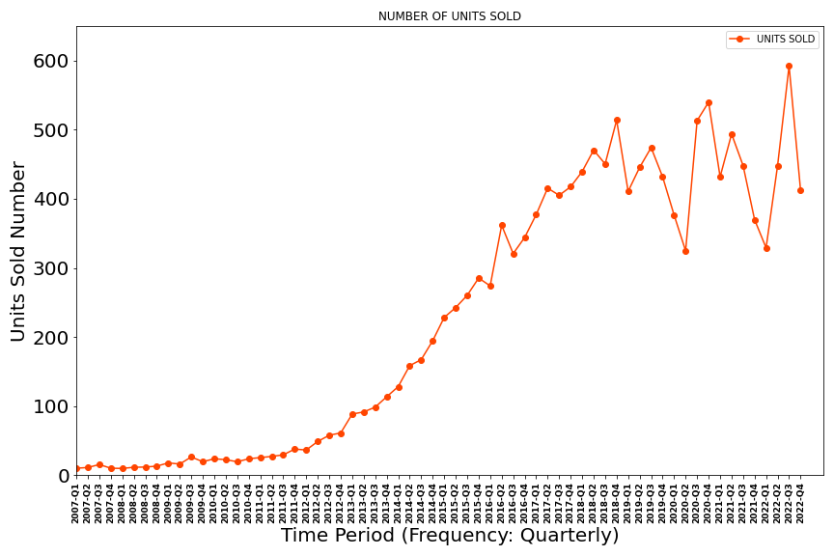
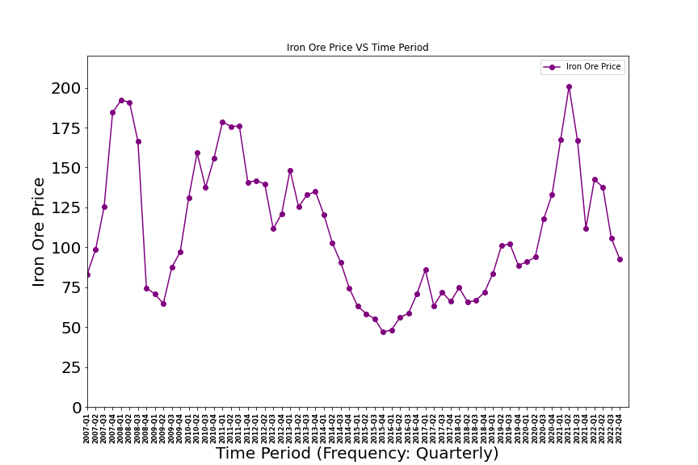
Analysis Process, visualised
Joseph
And another check…
Weighted Index
Iron Ore Price
# Units Sold

Slide 6
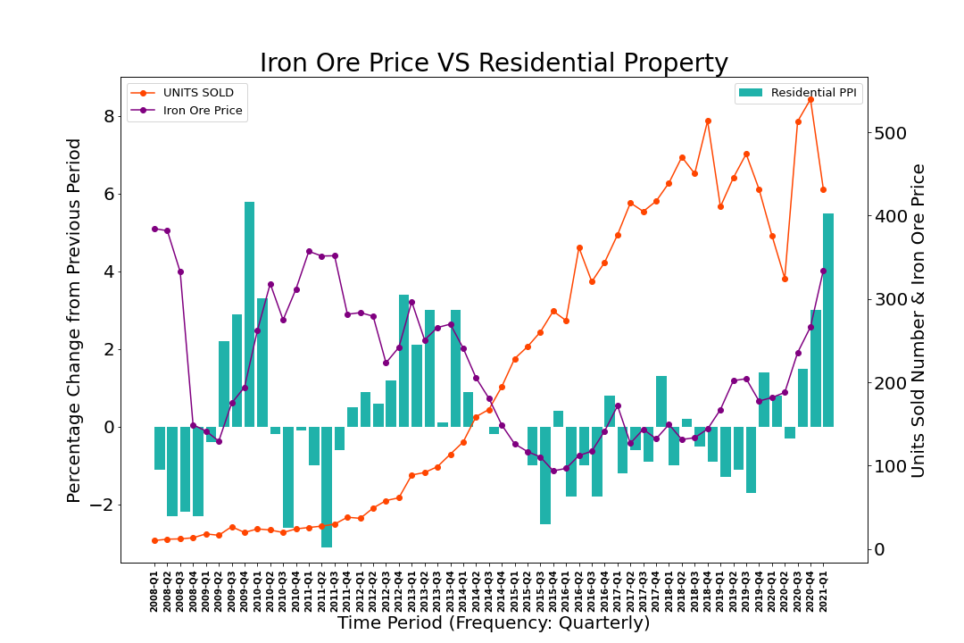
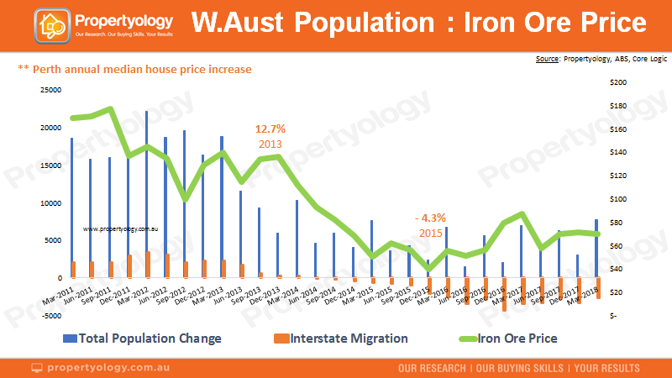
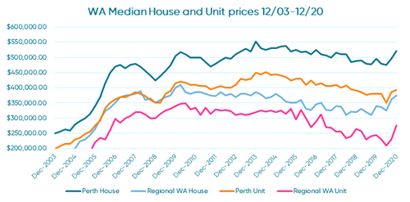
Johan
And the results are……
There is no-correlation of iron_ore price and Number of Unit Sold w.r.t time value because,the R-squared value is -0.3, which means no data fit in the model.
The results show an apparent correlation between iron ore price (purple line) and housing price index (green bar), however it also shows and inverse for the number of units sold (orange)
The reviewed data points to an increase of first home owner grants increasing in 2008 with the commencement of a rates easing cycle by the RBA in 2011 that coincide with a slowdown in housing stock in 2012.
Anectdotally…The correlation is not exact as the average household debt starts increasing in 2014 and the trend is still growing, this may be related to the increase in housing stock turnover regardless of the iron ore price
Weighted Index Variation of Pricing
-2% to 6% relative to Iron ore price
https://www.bmtqs.com.au/bmt-insider/population-records-broken-all-over-australia/
Source: Propertyology, ABS, REIWA
INFO: This graph shows the housing market in Perth has peaked in december 2013 with a median price of $550 As 2020, the housing market is impacted by Covid 19 early only, the trend quickly shift upward toward the end of 2020

Slide 7
Khansa
Summary did we answer the question?
Is there a correlation between the iron ore price cycle and Perth’s residential property prices? YES and NO
How do the iron price rise and fall impact the Perth residential property price weighted average index?
As shown there is a direct correlation between the house index and the ore price
How does the quarterly price vary over the research time period?
Relativaly follow the iron ore price with a weighted ratio of -2% to +6% at peaks
Our API call shows that the Established houses price index have observed clear rise/fall in term of growth. Established houses Index Numbers for Q4 of 2018 in Greater Perth: 104 Established houses Index Numbers for Q4 of 2019 in Greater Perth : 101.2 Established houses Index Numbers for Q4 of 2020 Greater Perth: 106.3 Established houses Index Numbers for Q4 of 2021 Greater Perth: 123.8
How does the relation ship between iron ore price rise and fall affect the future of the Perth property market –No results…however….

Slide 8
Is this proof of a relationship?
Joseph
Source: ABS, SQM Research
No, but prices on the global commodity markets will certainly have some effect on both our economy, and our property market.
Probably with a lag effect. It will take a few quarters of upturn on the one (commodities) to filter through to the property market, and it will also work slowly on the way down.
So, if things turn south in the commodity prices in the future – most commentators believe the current iron ore prices are unsustainable – be aware that this may feed negatively into both our local economy and property markets.
Western Australia, half of whose economy is resources, went through a six-year property downturn after the last mining boom ended.
For now though, it looks like commodities are up, and even if they come off a bit, they could remain relatively high for some time.
Time will tell.

Slide 9


Question Time?
Khansa
Joseph
Johan

